Slide 1
Exploiting WebSocket Vulnerabilities
Understanding and Manipulating WebSockets

Slide 2





The Team
Davide Cirimele 247438
Martina Suriano 252313
Gabriele Tassone 252153
Giovambattista Crudo (GB) 252133
Alessio Maresca 256622

Slide 3
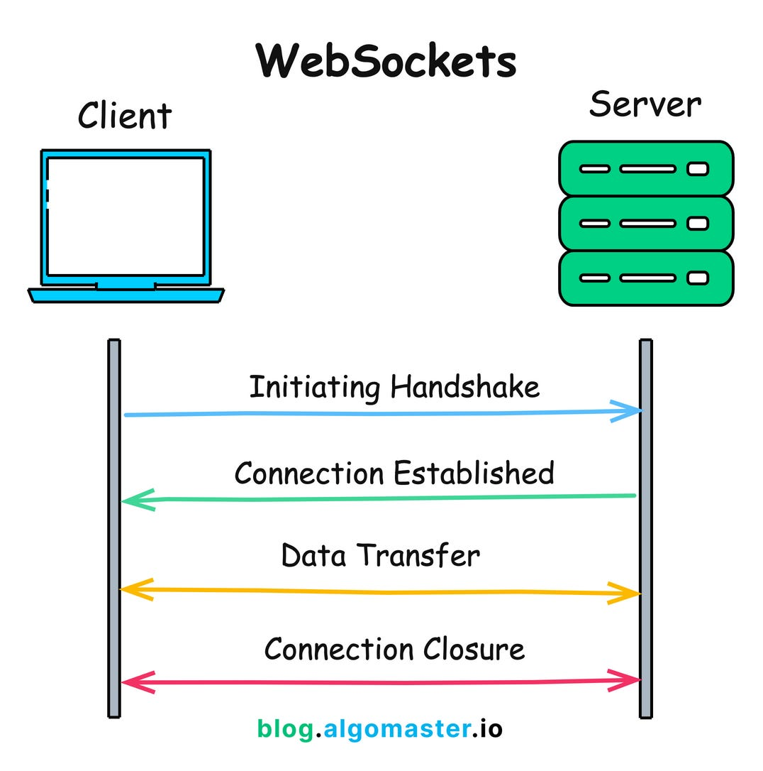
What is a WebSocket?
WebSockets are bi-directional, full duplex communications protocol, useful for streaming data or asynchronous traffic helping in constructing low-latency and server-initiated conversations.

Slide 4
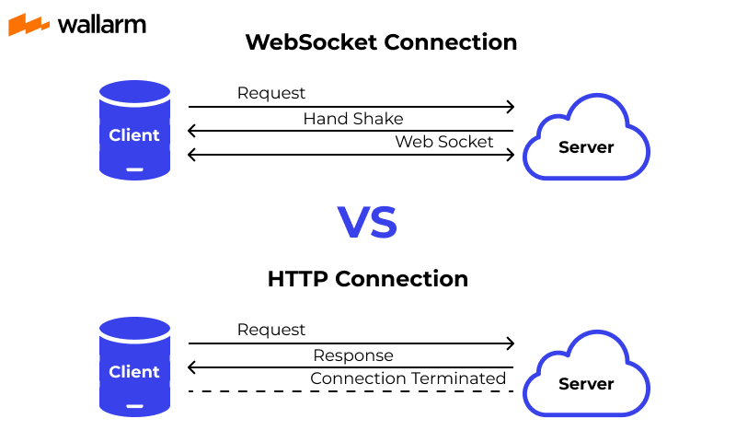
Why not HTTP?
HTTP is a powerful and a way more versatile mechanism, but it is still request/response based, whilst there are some scenarios in which we need to have a continuous connection in order to avoid polling/long polling.
This scenarios are usually:
Push Notification
Group Chats
Streaming

Slide 5
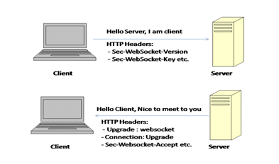
WebSocket Handshake
Initiated over HTTP and establishes a long-lived connection. Involves client sending a handshake request and server responding to upgrade the connection. Connection remains active for message exchanges.

Slide 6
WebSockets Security
The main difference between ws and wss is that, one uses tls, one doesn’t. This helps us in understanding that websockets are just a technology, that is not secure by itself. WS need to be made secure with proper setup.

Slide 7
Common WebSocket… Vulnerabilities?
WebSockets enlarge the attack surface of an already unsafe application, making it easier for attackers to inject malicious payloads. Common flaws in WebSocket implementation are:
Unvalidated messages over the socket
Misplaced trust in HTTP headers. Session handling mechanisms. DDoS Attack

Slide 8
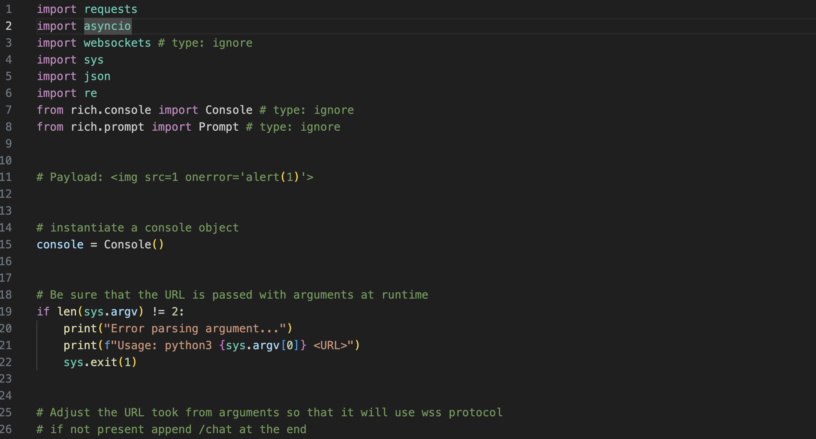

Slide 9
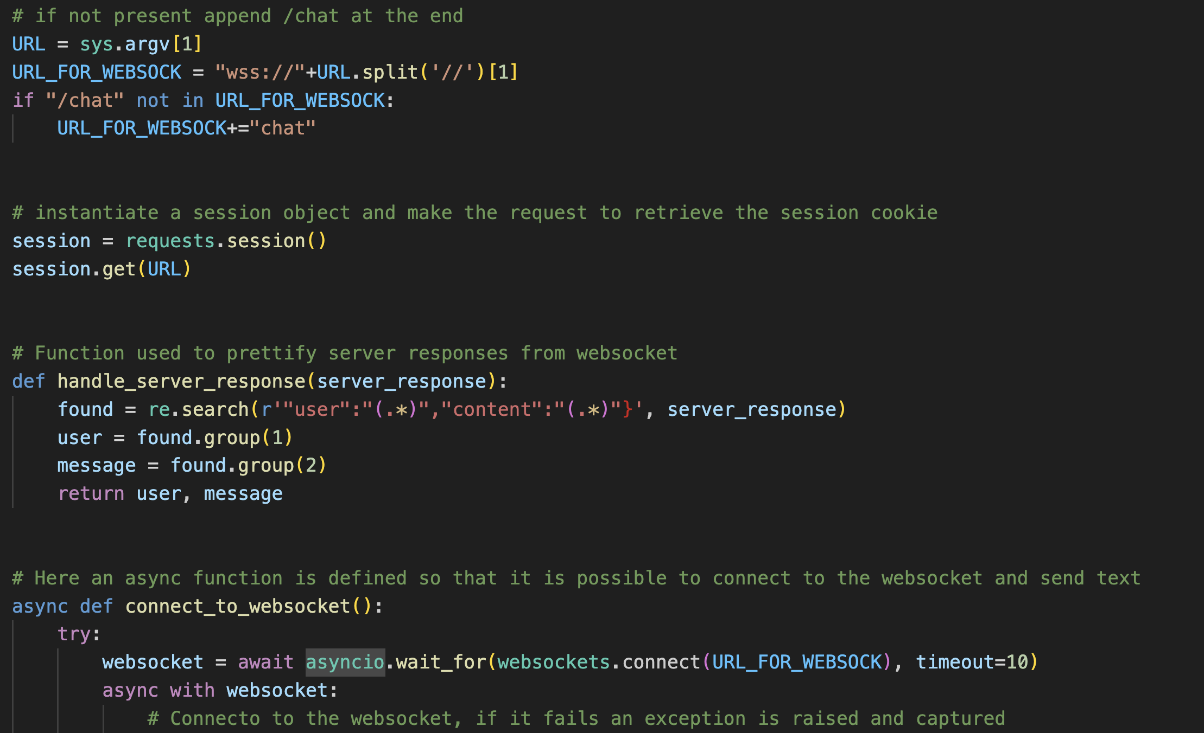

Slide 10
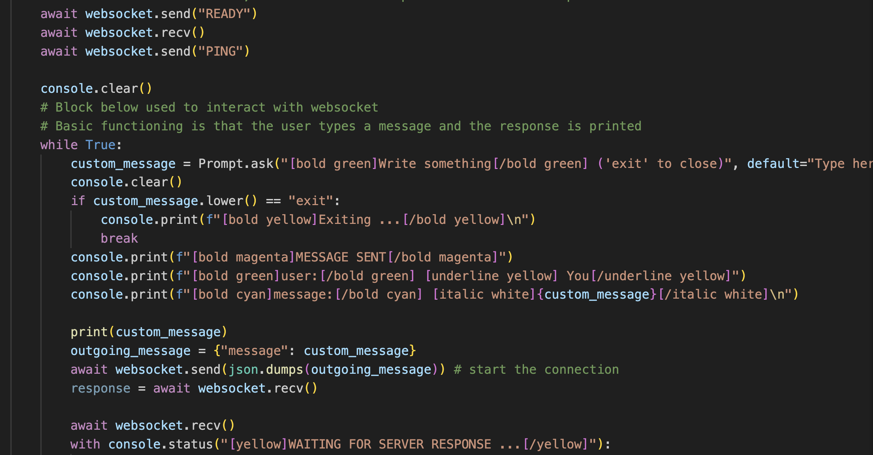

Slide 11
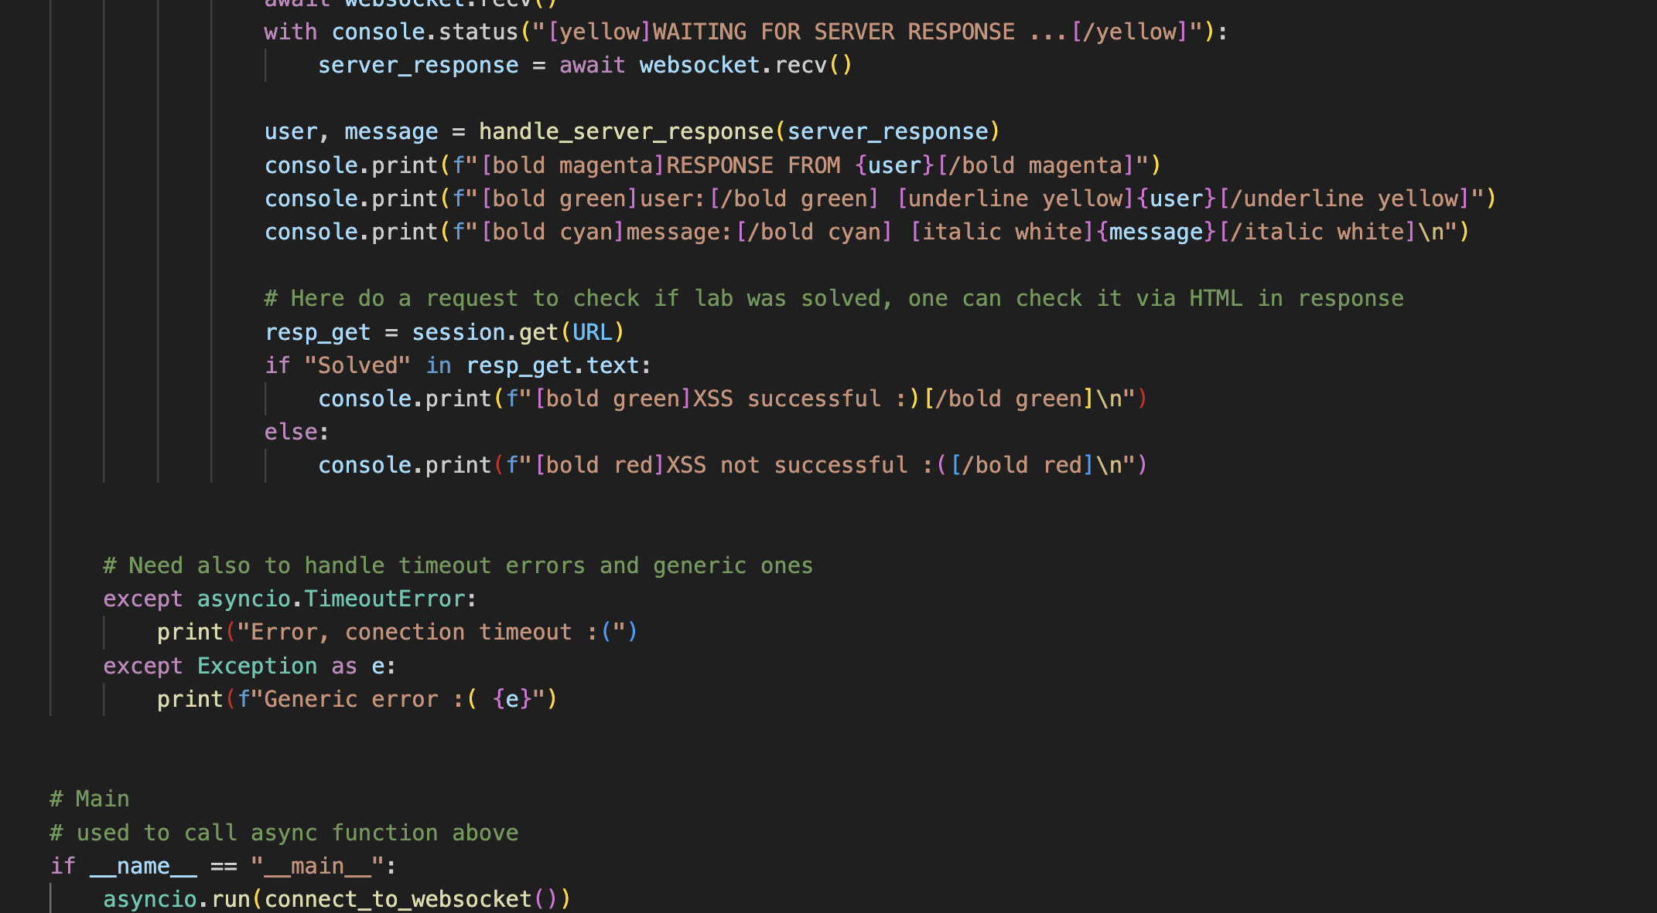

Slide 12
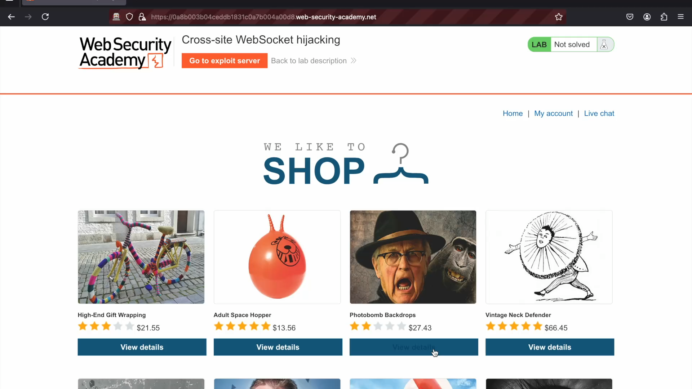

Slide 13
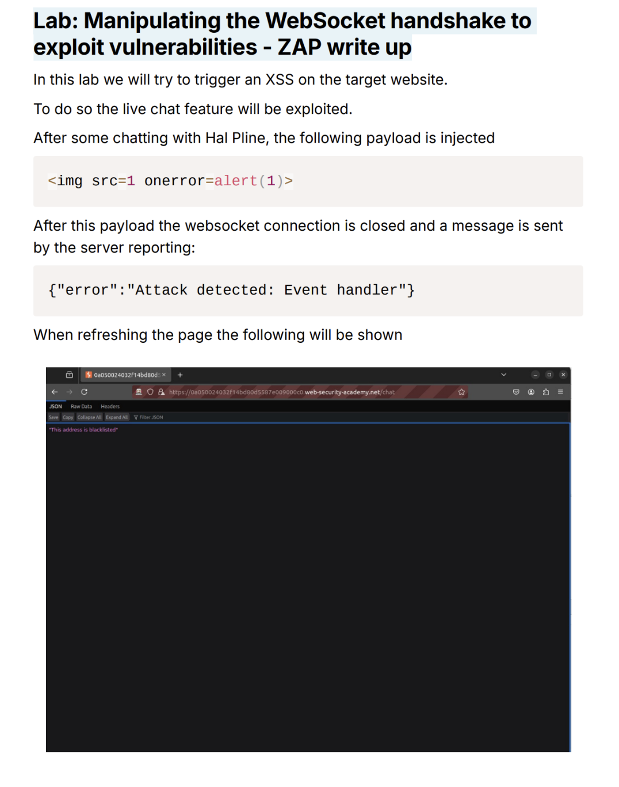

Slide 14
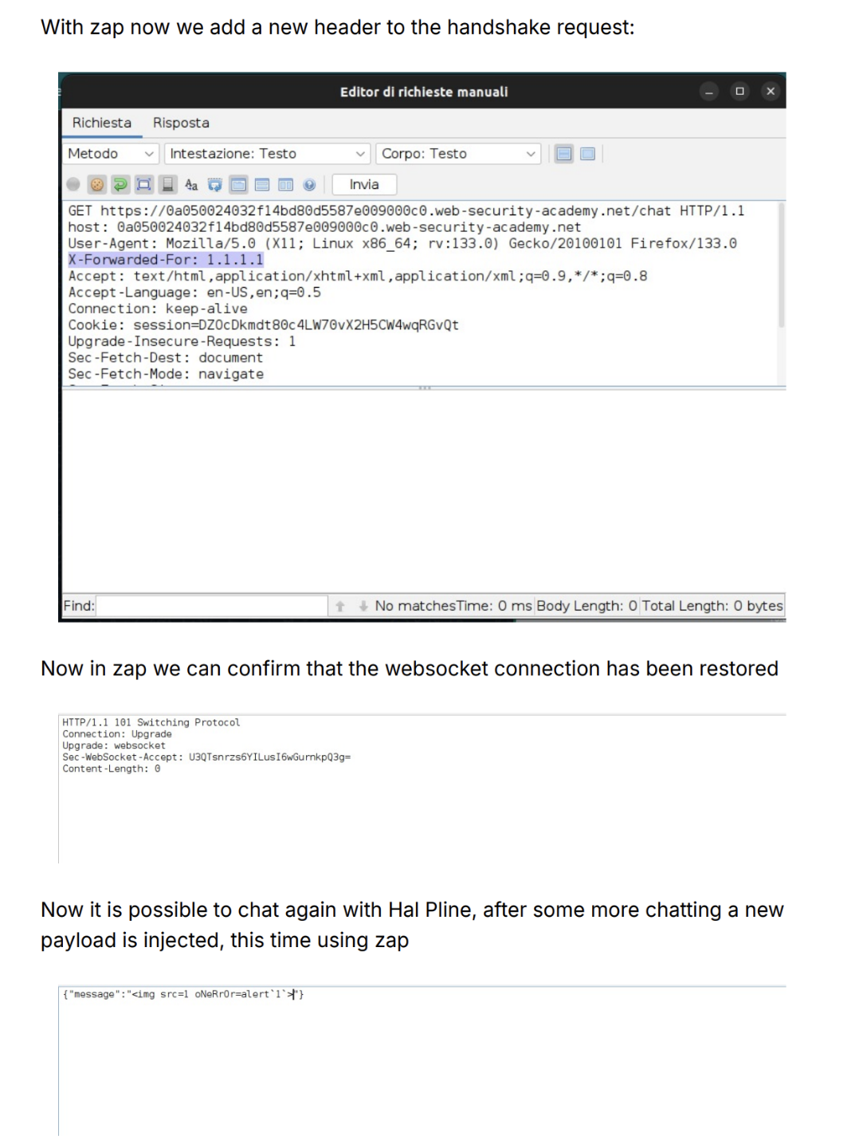

Slide 15
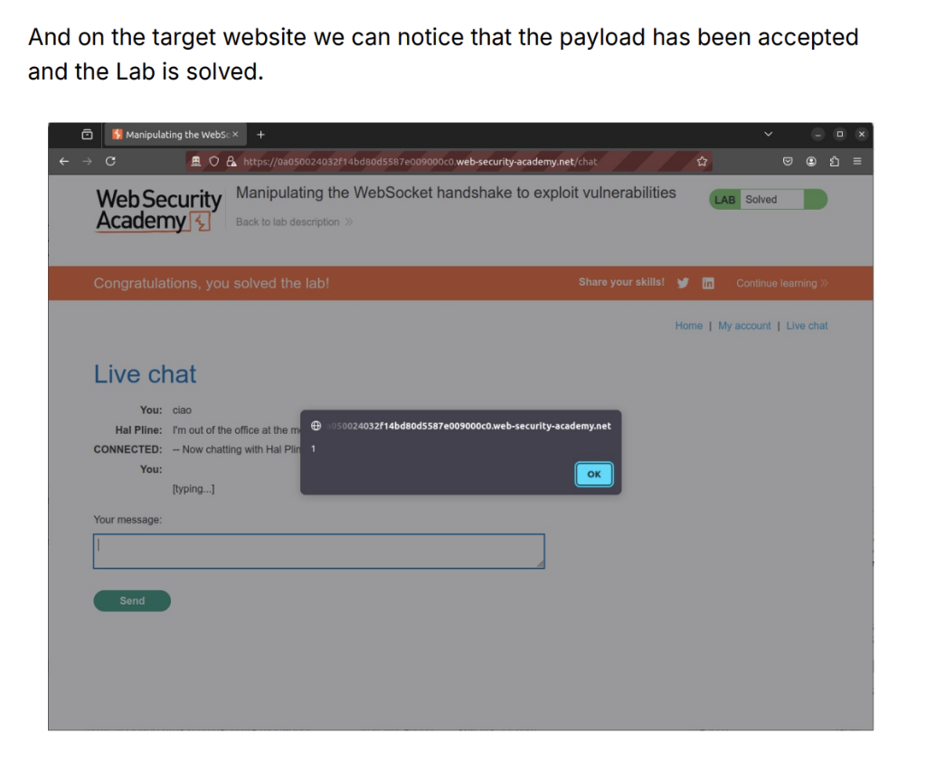

Slide 16
Preventing WebSocket Vulnerabilities
Use WSS:// for secure WebSocket connections. Protect handshake messages against CSRF. Treat data received as untrusted and require user authentication.
Validate client inputs

Slide 17
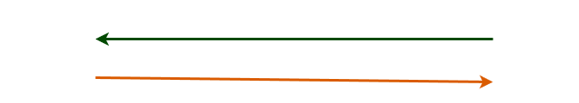
Subscription Model
Another useful prevention technique is a subscription model in which the client does not handle the message directly but keeps a connection with server and gets notified whenever new data is received

Slide 18
Conclusion
WebSocket are a useful tool for a continuous connection. They are not vulnerable by themselves, they just enlarge the attack surface. Knowing how to code safely is the first counter-meausure

Slide 19
7h4nk y0u!

Slide 20


